Slide 1
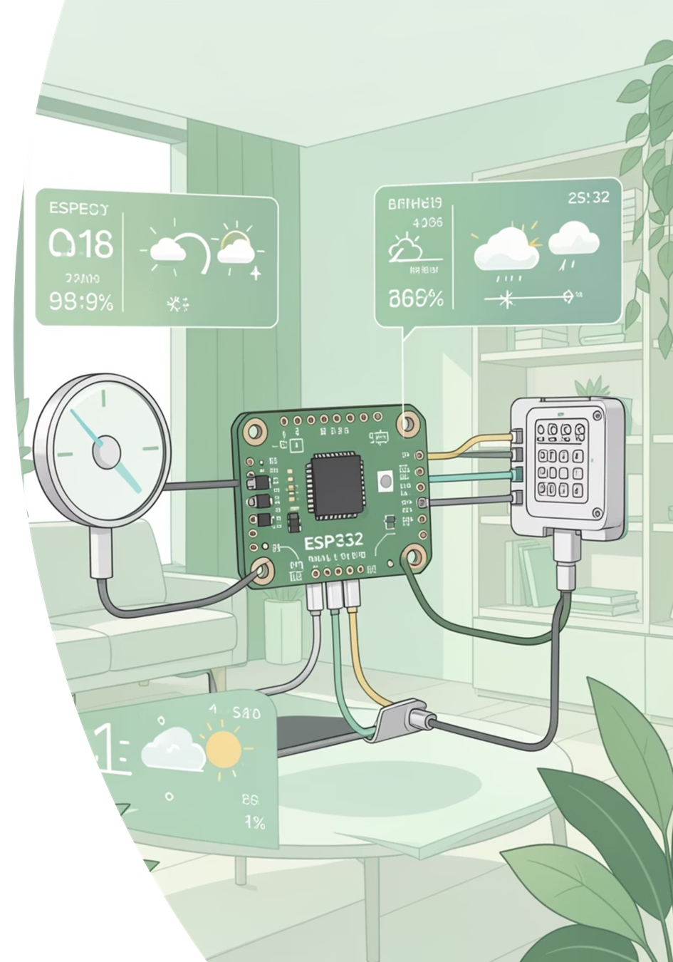
Smart Weather Forecasting Station (IoT)
ESP32 + BMP280 + SHT40 + IR Sensor | ThingSpeak + MQTT | Deep Sleep Power Saving

Slide 2
Problem Statement
Weather conditions change rapidly, and manual monitoring is not reliable for real-time applications.
This project develops a low-cost ESP32-based smart weather station .(To measure temperature, humidity, pressure, and light intensity, and upload data to ThingSpeak/MQTT for remote monitoring with low power deep sleep support.)

Slide 3
Abstract
Weather forecasting is the application of science and technology to predict atmospheric conditions for a specific location.
In this project, we developed an ESP32 based Smart Weather Forecasting Station that measures temperature, humidity, pressure, and light intensity (LDR) in real time.
The collected sensor data is displayed on an OLED screen and uploaded to the ThingSpeak cloud for monitoring and analysis.
The system also publishes data through MQTT for IoT based applications and remote access.
To reduce power consumption, the ESP32 uses deep sleep mode, making it suitable for agriculture, smart cities, and environmental monitoring.

Slide 4
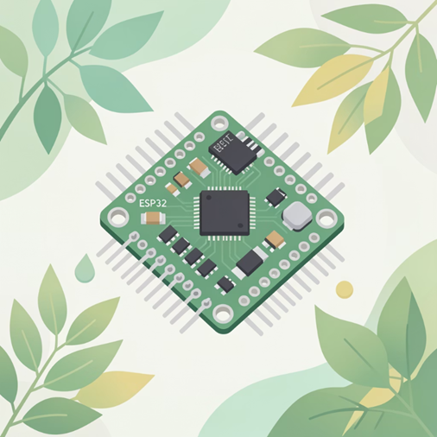
Components / Requirements
Hardware
ESP32 Dev Board
BMP280 (Temperature + Pressure)
SHT40 (Humidity + Temperature)
OLED Display (SSD1306, I2C)
LDR Sensor (Day/Night detection)
Jumper wires + Breadboard
WiFi Network (Hotspot/Router)
Software / Platforms
Arduino IDE
ESP32 Board Package
ThingSpeak Account + API Key
MQTT Broker on Raspberry Pi (Mosquitto)
Libraries: Adafruit_BMP280, SSD1306, PubSubClient, HTTPClient
The ESP32 is a powerful, low-cost microcontroller with integrated Wi-Fi and Bluetooth, making it ideal for IoT applications.

Slide 5


Block Diagram
Sleep mode
Sensor
(BMP280,
LDR,SHT40)
ESP32
Microcontroller
OLED Display
ThingSpeak
Platform
Wifi
network
MQTT Broker

Slide 6
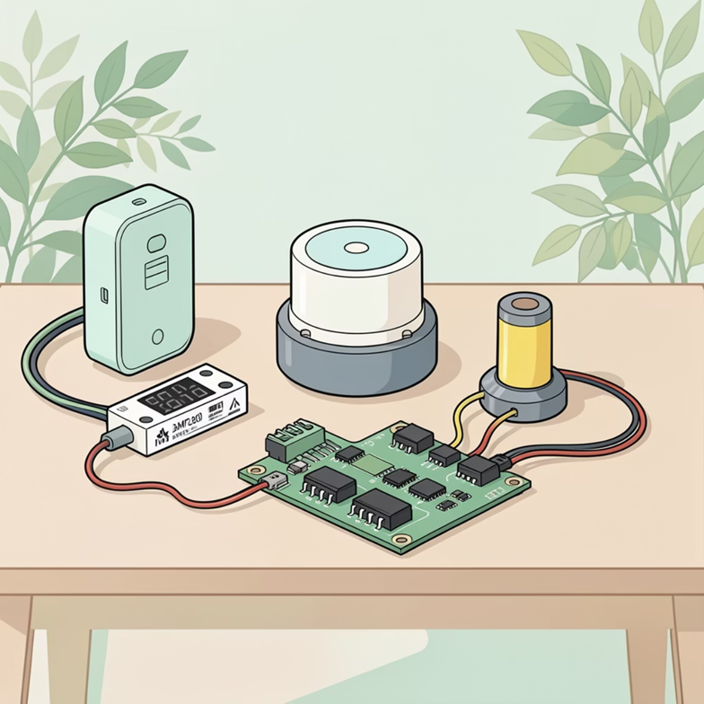
Working (Flow)
ESP32 connects to WiFi using SSID & Password.
Reads BMP280 temperature & pressure values.
Reads SHT40 humidity (high precision mode).
Reads LDR sensor to identify Day (0) / Night (1).
Displays values on OLED (SSD1306).
Uploads data to ThingSpeak using HTTP GET request.
MQTT messages are parsed in C and written to a local file for data storage
ESP32 enters deep sleep for 3 minutes and repeats cycle.

Slide 7
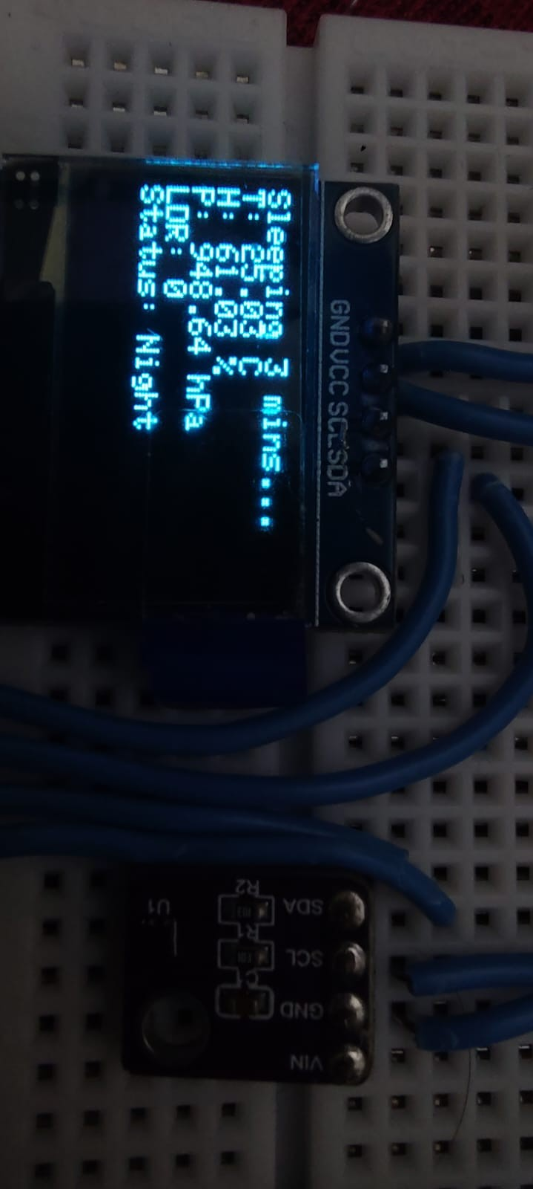
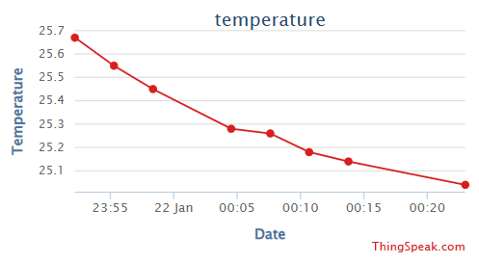
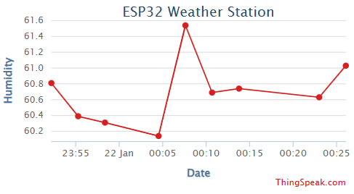
Key Features & Output
Live OLED display of weather parameters.
Cloud visualization using ThingSpeak fields:
Field1- Temperature,
Field2- Humidity,
Field3- Pressure,
Field4- LDR (Day/Night)
MQTT messages are parsed in C and written to a local file for data storage.
Deep sleep mode reduces power usage for long-term deployment.

Slide 8

Real-world Applications & Impact in India
Agriculture: Optimising irrigation schedules and crop management based on hyper-local weather data, especially crucial for monsoon-dependent farming.
Smart Cities: Monitoring urban air quality, predicting localised flooding, and managing infrastructure efficiently.
Disaster Management: Early warning systems for heavy rainfall, storms, and other natural calamities.
Research & Education: Providing valuable data for meteorological studies and educational projects.

Slide 9
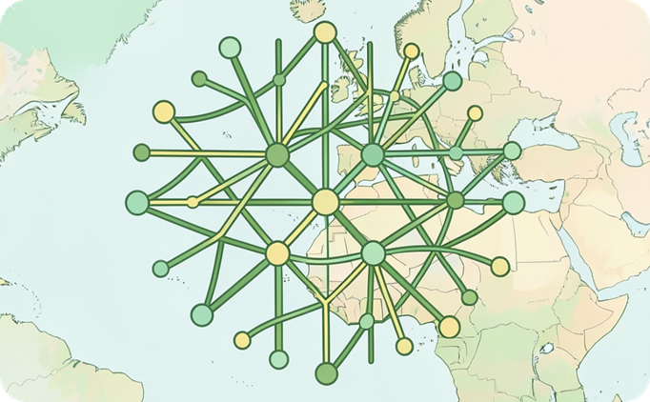
Conclusion & Future Scope
A low-cost smart weather station is successfully implemented using ESP32.
Data is monitored locally (OLED) and remotely (ThingSpeak + MQTT).
Power efficiency is improved using deep sleep scheduling.
Future Scope
Add rain sensor + wind speed sensor (anemometer)
Add air quality sensor (MQ135 / PMS5003)
AI-Powered Forecasting:Integrating machine learning algorithms to enhance predictive accuracy and identify complex weather patterns.

